Slide 1


E-commerce Customer Analysis
CHURN ANALYSIS

Slide 2

BUSINESS OBJECTIVE
PERFORM: Perform analysis of the customer base of an e-commerce site.
IDENTIFY: Identify characteristics of customers who have stopped using the service.
DEVELOP: Develop strategies to reduce customer churn.

Slide 3
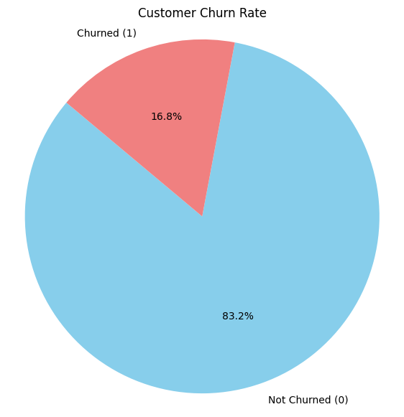
Figure 1
Observation: Customers retained account for 83.2%, indicating strong loyalty, while 16.8% of customers have churned, highlighting a potential concern.
CUSTOMER CHURN ANALYSIS RATE

Slide 4
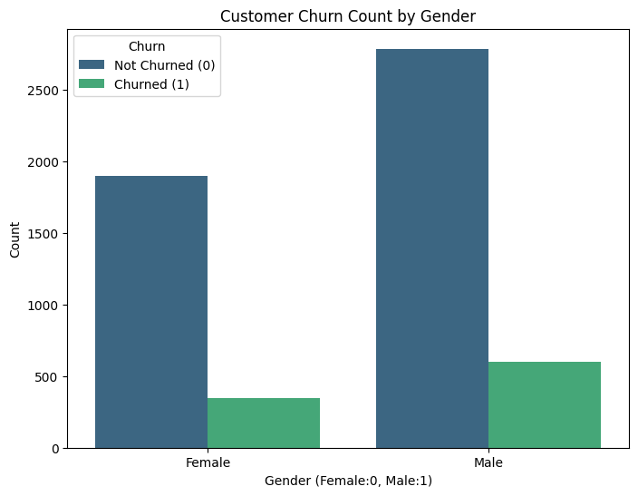
Figure 2
The bar chart presents customer retention and churn rates segmented by gender. For both genders, the majority did not churn, while fewer customers churned. The green bars show the actual count of churned customers for each gender.
Observation: This analysis highlights the need to investigate gender-specific factors influencing customer retention and churn. Understanding these patterns can help businesses tailor their engagement strategies to reduce churn and enhance customer loyalty.
I

Slide 5
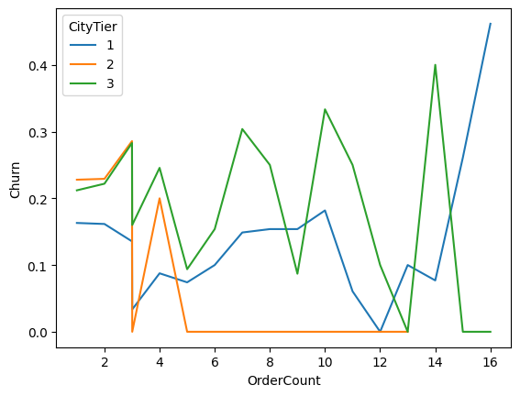
Figure 3
Observation: The Line plot visualizes the relationship between Order Count and Churn Rate, segmented by City Tier(1,2 and 3). Each tier exhibits distinct churn patterns.
Tier 1(Blue) has a relatively stable churn rate but spikes at higher order counts. Tier2(orange) has the lowest churn rate, and Tier 3 cities experience the highest churn fluctuations.
CHURN RATE ANALYSIS BY CITY TIER

Slide 6
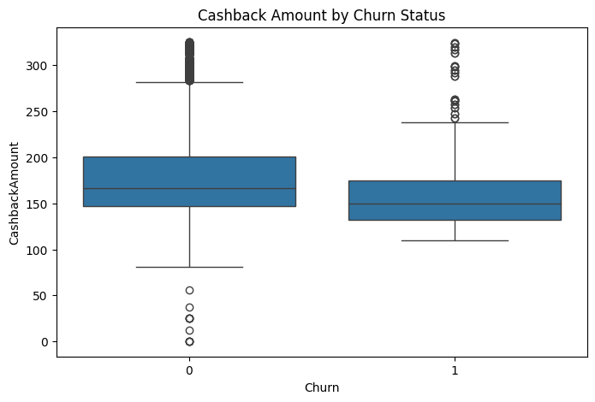
Figure 4
Observation: The box plot for cashback amounts by Churn Status reveals a clearer difference.
Customers who churned (1) usually receive a lower median cashback compared to those who did not churn (0). The distribution of cashback amounts seems higher for non-churned customers. This suggests that customers getting higher cashback amounts are less likely to churn.

Slide 7
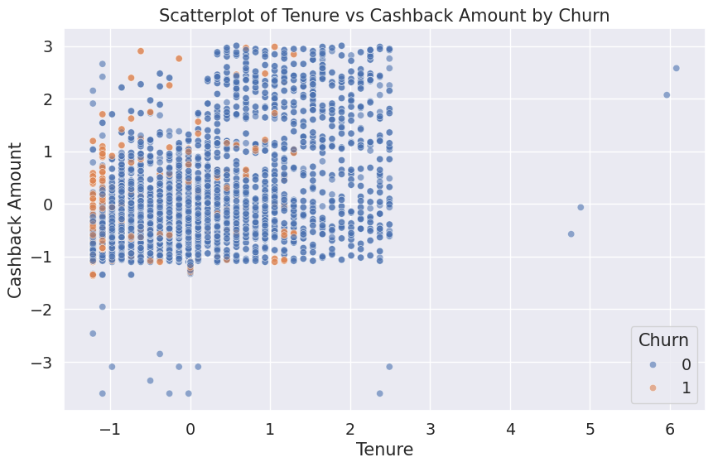
Figure 5
Observation: The scatterplot of Tenure vs Cashback Amount by Churn is showing churned customers as churned points
Churn is higher among customers with low tenure.
Churned customers generally receive lower cashback amounts.
Customers with high tenure and high cashback are mostly non-churned, cashback may help retain loyal customers.
No clear separation by tenure and cashback alone, other factors also drive churn.

Slide 8
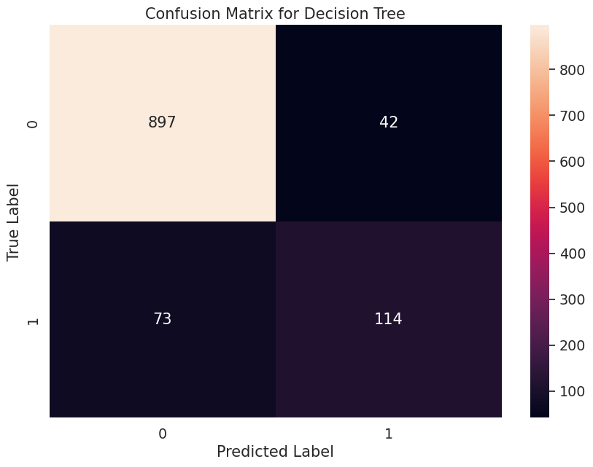
Figure 6
Model Used: Decision Tree Classifier
Key Performance Metrics:
Accuracy: 89.78%
Precision: 73.07%
Recall: 60.96%
Confusion Matrix Insights:
True Negatives (TN): 897 (Correctly predicted non-churners)
False Positives (FP): 42 (Incorrectly predicted as churners)
False Negatives (FN): 73, Low, indicating strong recall performance.
True Positives (TP): 114, Correctly predicted.
Decision Tree Classifier Performance

Slide 9
Conclusion & Recommendations
Customer churn remains a crucial challenge for e-commerce businesses, directly impacting revenue and long-term growth. Our analysis provides valuable insights into churn behavior, helping businesses make informed decisions to enhance customer retention strategies.
Key Takeaways:
Overall churn rate is 16.8%, with 83.2% retention
Early-tenure customers face the highest churn risk
Tier 2 cities have the most stable customer base
Male customers exhibit higher churn despite retention strength
Recommendations:
Focus onboarding & engagement in first 10 years of tenure
Expand efforts in Tier 2 cities as a growth opportunity
Implement gender-specific engagement strategies
Leverage predictive modeling for proactive retention
By adopting a customer-centric approach and leveraging data-driven insights, businesses can significantly reduce churn, strengthen customer relationships, and drive sustainable growth.

Slide 10


